Slide 1
Lab1: Exploring the Data Engineering Lifecycle and Stakeholder Roles

Slide 2
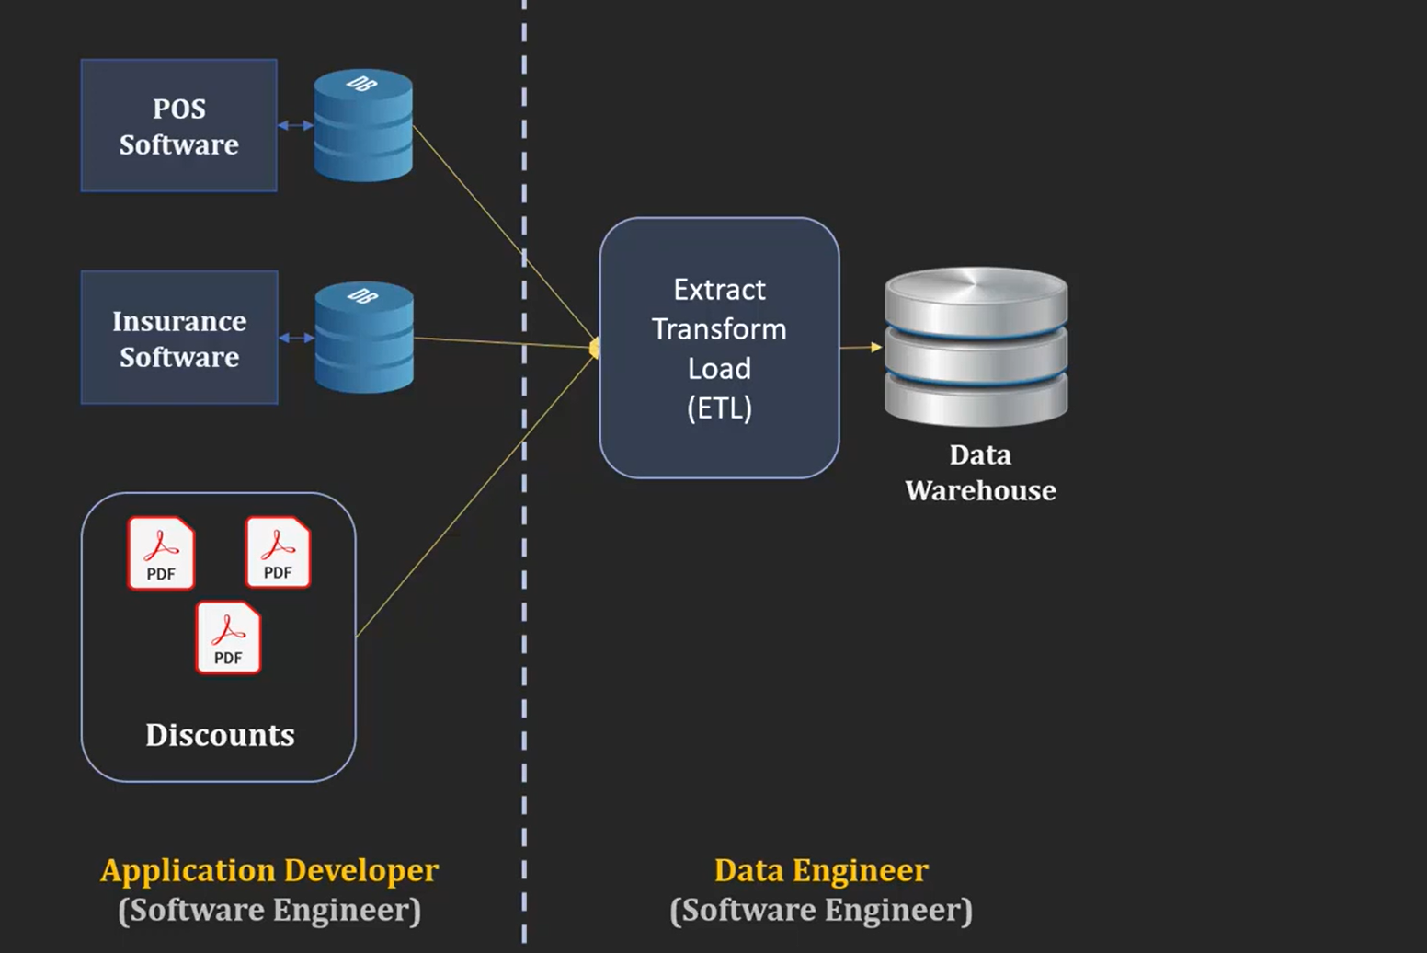

Slide 3
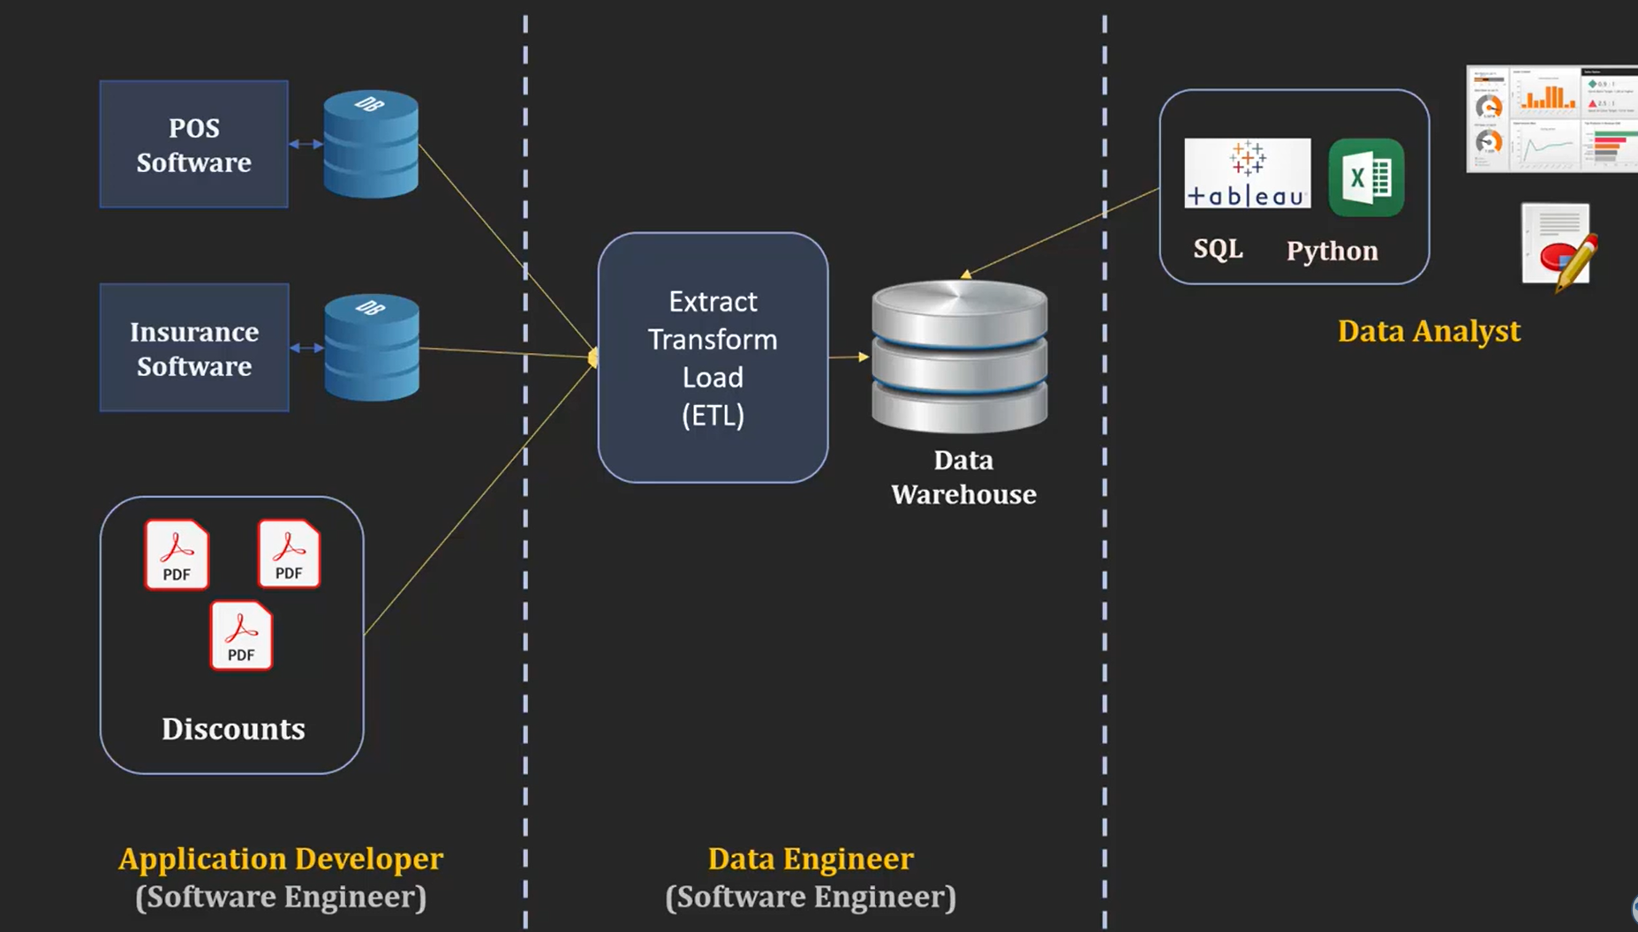

Slide 4
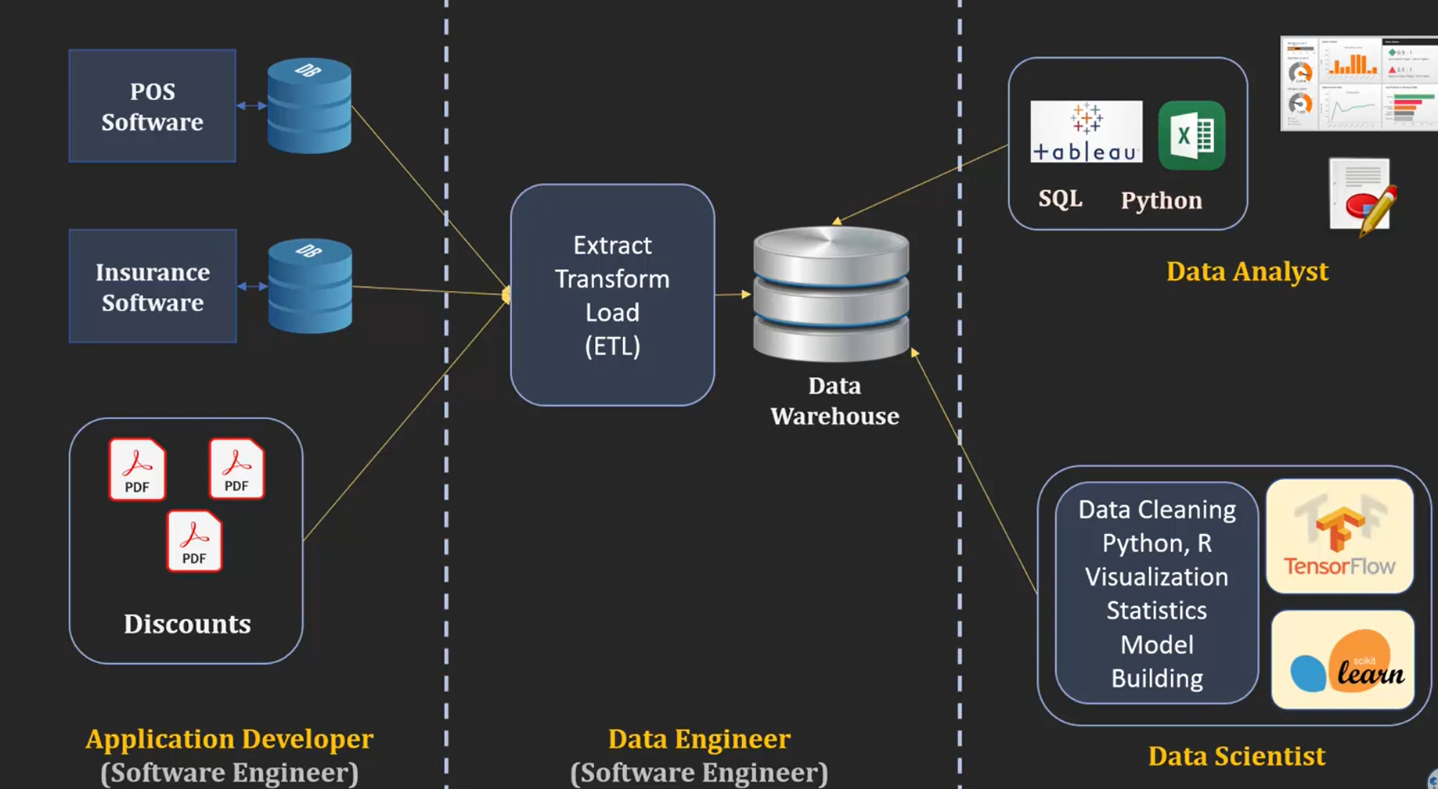

Slide 5
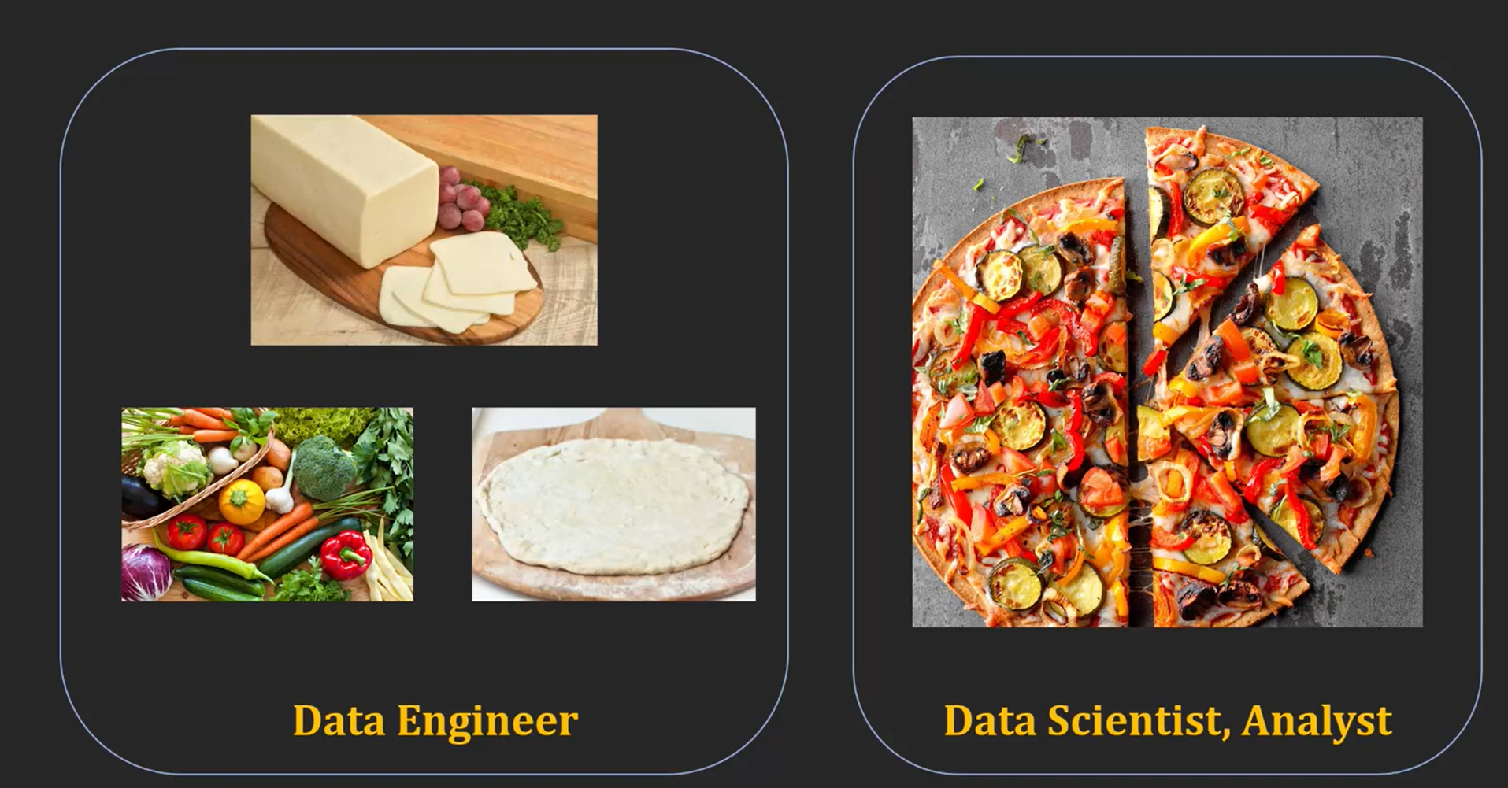

Slide 6
Data Scientist
A data scientist is a professional who works with an enormous amount of data to come up with compelling business insights through the deployment of various tools, techniques, methodologies, algorithms, etc.
Skill required: To become a data scientist, one should have technical language skills such as R, SAS, SQL, Python, Hive, Pig, Apache spark, MATLAB.
Data scientists must have an understanding of Statistics, Mathematics, visualization, and communication skills.

Slide 7
Data Analyst:
Data analyst is an individual, who performs mining of huge amount of data, models the data, looks for patterns, relationship, trends, and so on. At the end of the day, he comes up with visualization and reporting for analyzing the data for decision making and problem-solving process.
Skill required: mathematics, business intelligence, data mining, and basic knowledge of statistics.
You should also be familiar with some computer languages and tools such as MATLAB, Python, SQL, Hive, Pig, Excel, SAS, R, JS, Spark, etc.

Slide 8
Machine Learning Expert
The machine learning expert is the one who works with various machine learning algorithms used in data science such as regression, clustering, classification, decision tree, random forest, etc.
Skill Required: Computer programming languages such as Python, C++, R, Java, and Hadoop.
You should also have an understanding of various algorithms, problem-solving analytical skill, probability, and statistics.

Slide 9
Data Architect
A Data Architect is responsible for implementing the blueprints of a company’s data platform. This blueprint or architecture delineates various models, policies, rules that govern the storage of data as well as its use in the organizations.
Some of the important tools used by a Data Architect are XML, Hive, SQL, Spark and Pig.

Slide 10
Data Engineer
A data engineer works with massive amount of data and responsible for building and maintaining the data architecture of a data science project. Data engineer also works for the creation of data set processes used in modeling, mining, acquisition, and verification.
Skill required: Data engineer must have depth knowledge of SQL, MongoDB, Cassandra, HBase, Apache Spark, Hive, MapReduce, with language knowledge of Python, C/C++, Java, Perl, etc

Slide 11
Aspect | Data Engineer | Data Analyst | Data Scientist
Primary Role | Build and maintain data pipelines, architecture, and infrastructure | Analyze data to generate insights and reports | Develop models and algorithms to extract insights and predictions
Focus Area | Data acquisition, storage, processing (ETL) | Data visualization, reporting, trend analysis | Statistical modeling, machine learning, predictive analytics
Tools/Technologies | SQL, Python, Spark, Hadoop, Kafka, Airflow, AWS, GCP | Excel, SQL, Tableau, Power BI, Python (basic), R (basic) | Python, R, TensorFlow, PyTorch, Scikit-learn, Jupyter, SQL
Data Handling | Works with raw, unstructured or semi-structured data | Works with cleaned, processed data | Uses curated datasets and performs deep analysis or modeling
Skills Required | Programming, cloud platforms, database management, data warehousing | Analytical thinking, SQL, dashboards, communication | Machine learning, statistics, domain expertise, programming
Output | Scalable data pipelines, data lakes/warehouses | Dashboards, reports, summaries | Predictive models, AI/ML solutions, data-driven strategies
Educational Background | Computer Science, IT, Engineering | Business, Economics, Statistics, Computer Science | Mathematics, Statistics, Computer Science, Data Science
Goal | Ensure reliable, accessible, and clean data | Provide data-driven insights for decision making | Discover trends, build models to solve complex problems

Slide 12

ETL Process in Data Science

Slide 13
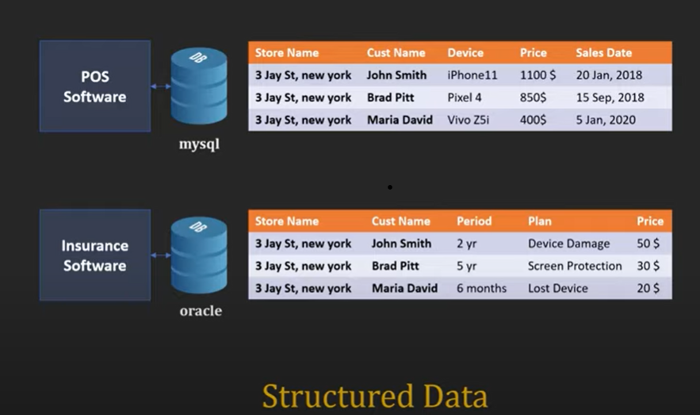

Slide 14
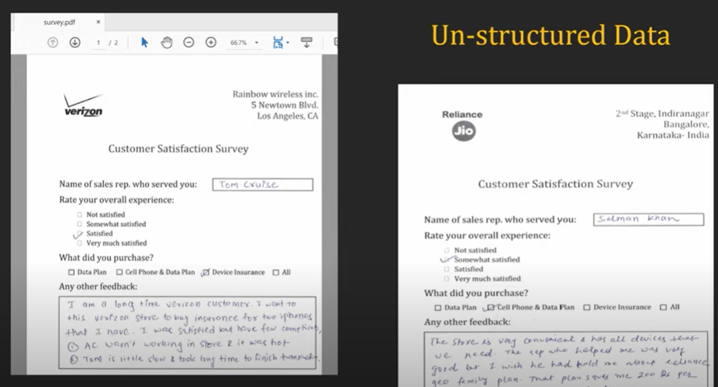

Slide 15
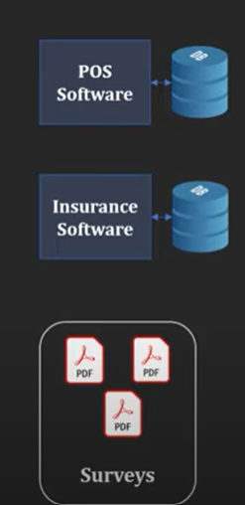
Which store is performing best in term of device and sales total
In terms of customer satisfactions which Store employee ranks the best
Holiday session is coming which region is going to have maximum traffic of customers?

Slide 16
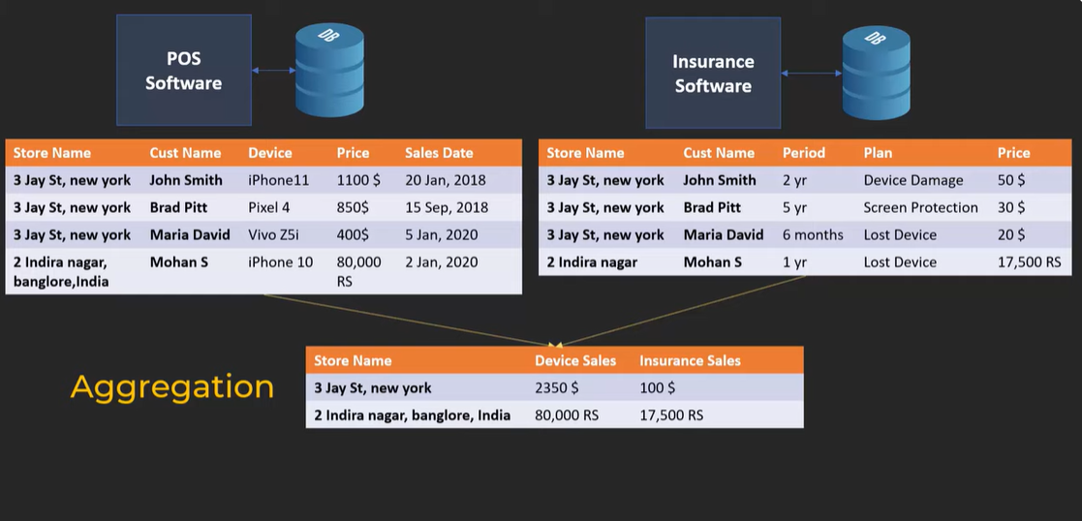

Slide 17
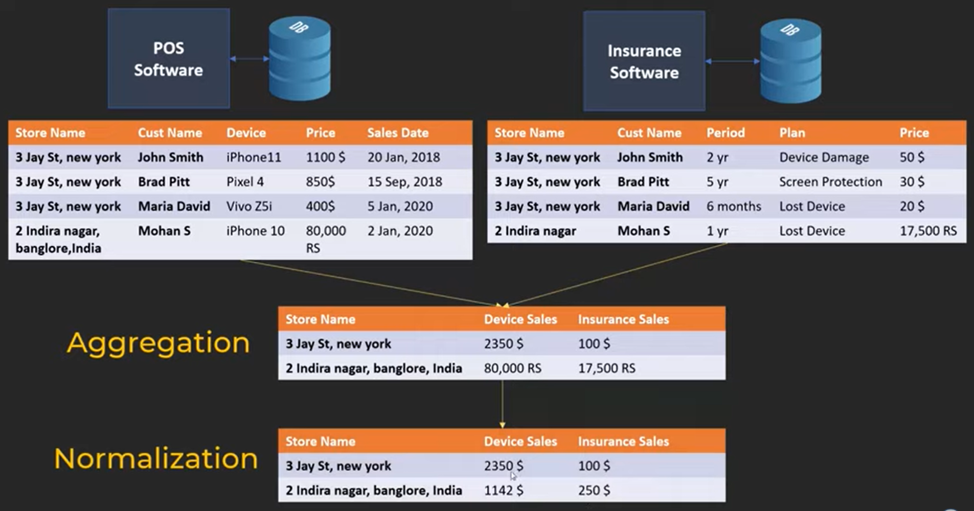

Slide 18
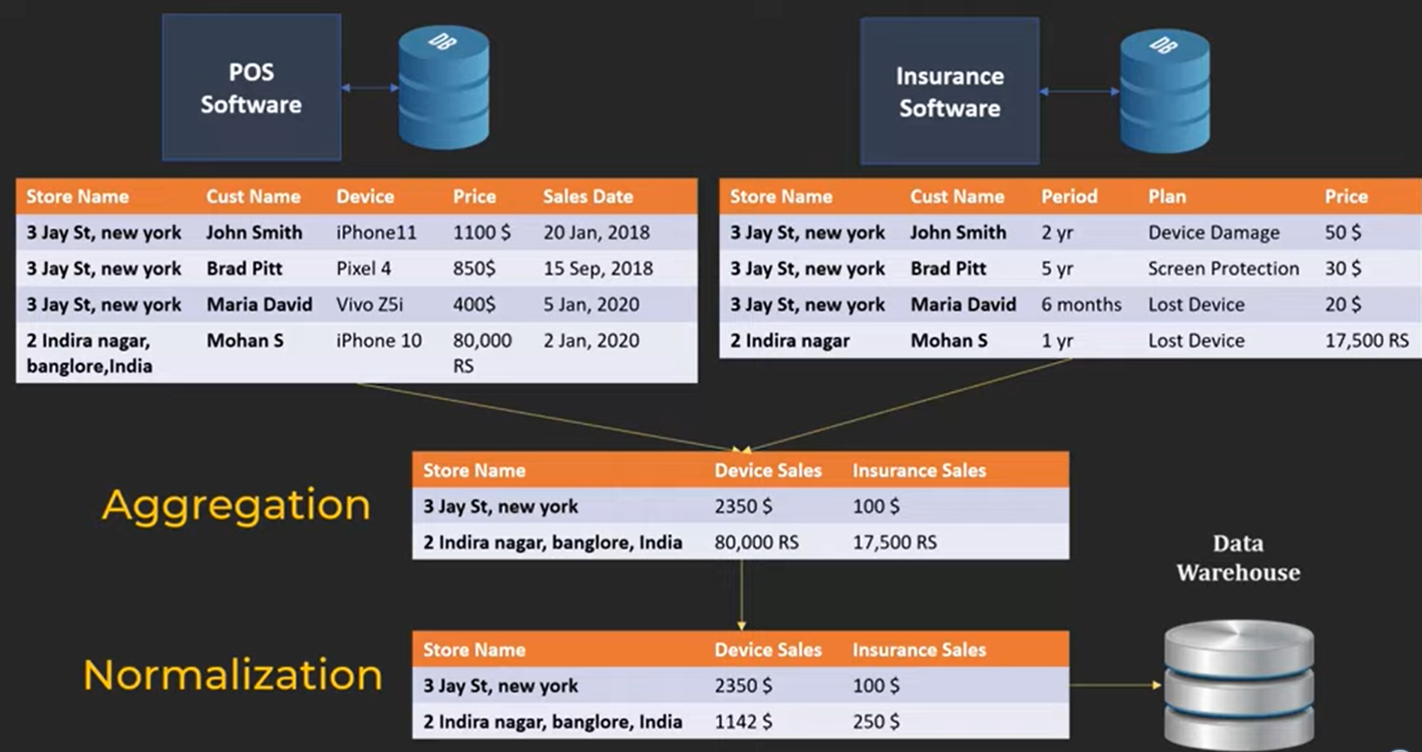

Slide 19
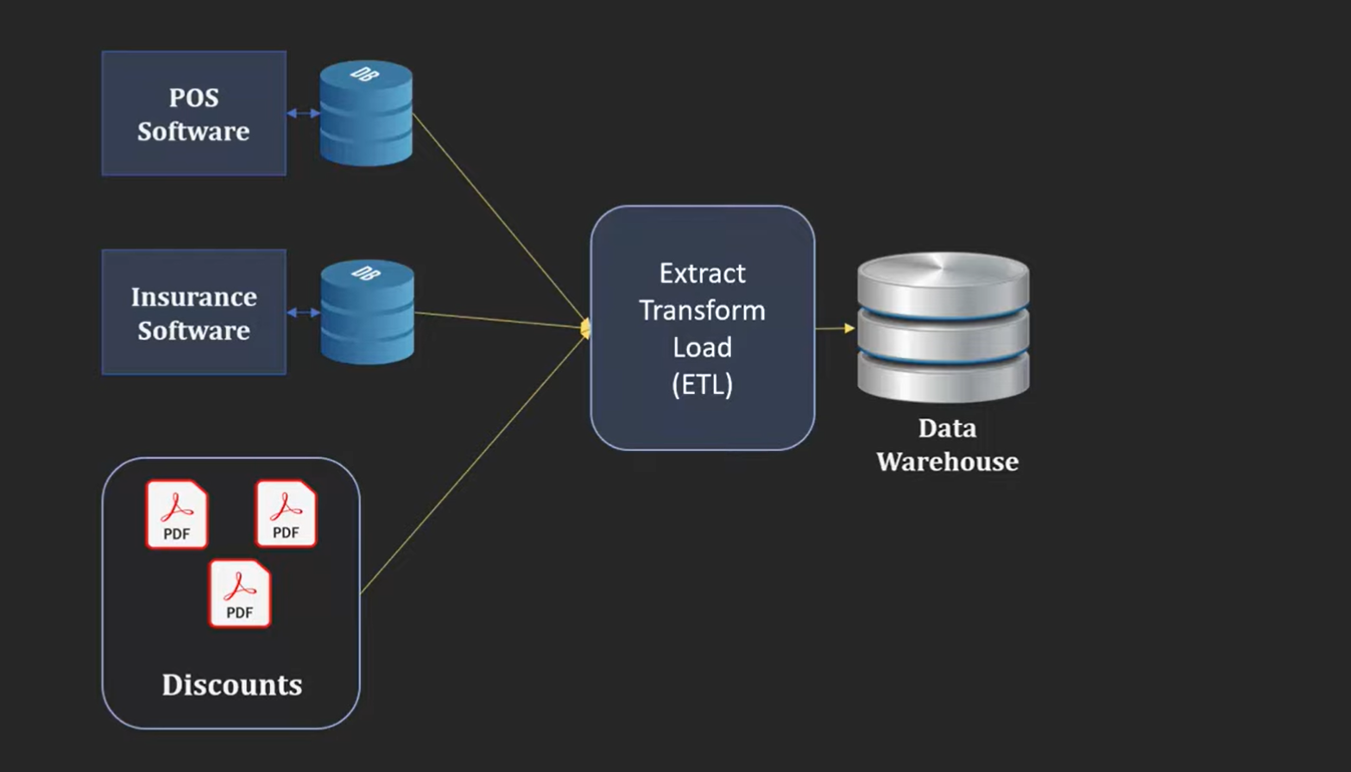

Slide 20
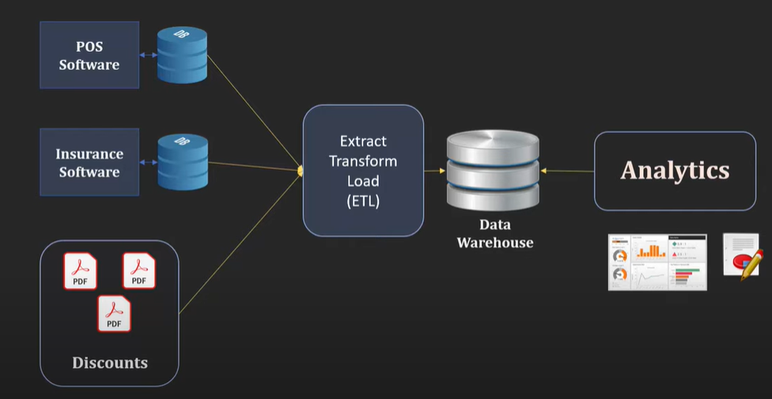

Slide 21
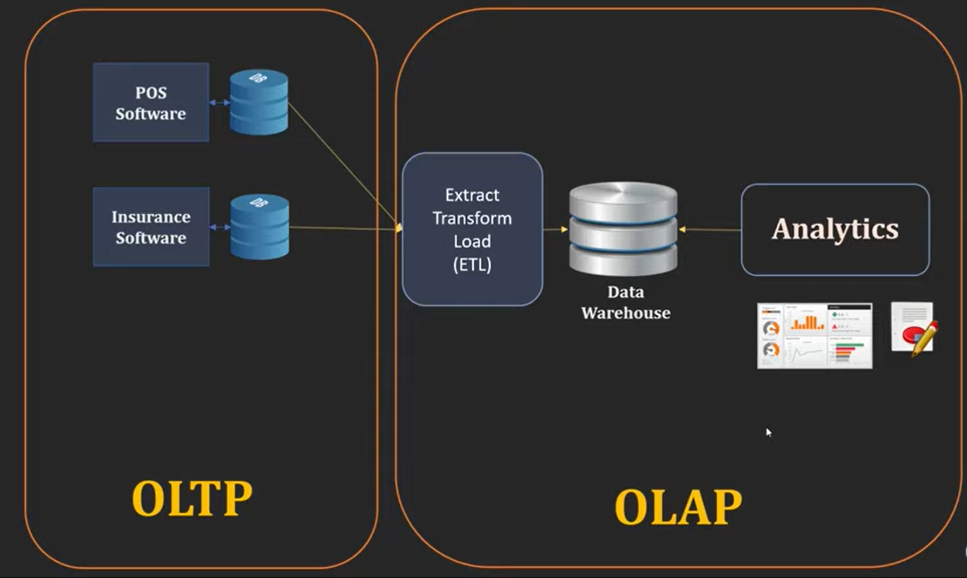
Online transactional processing (OLTP) enables the real-time execution of large numbers of database transactions by large numbers of people, typically over the internet.
Online analytical processing, is technology for performing high-speed complex queries or multidimensional analysis on large volumes of data.

Slide 22



ETL Tools

Slide 23


Data warehouse
A data warehouse is a centralized system used to store and manage large volumes of data from various sources, enabling efficient analysis and reporting.

Slide 24
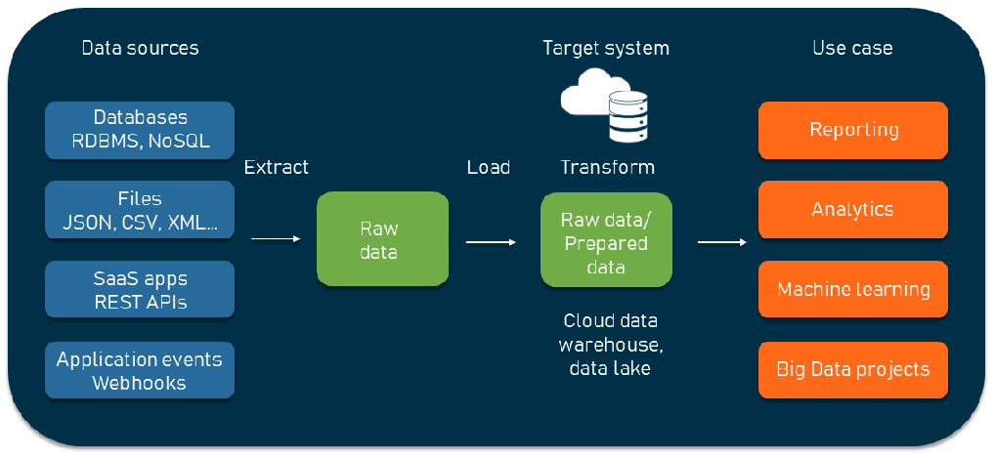
ELT

Slide 25
ELT VS ETL
Aspect | ETL | ELT
Order of Operations | Extract → Transform → Load | Extract → Load → Transform
Where Transformation Happens | Outside the data warehouse (in a separate tool or server) | Inside the data warehouse using its own computing power
Best Fit | Traditional systems were data needs cleaning before storage | Modern cloud platforms (e.g., Big Query, Snowflake) that handle raw data efficiently

